Slide 1

JAVACORE FINAL ASSIGNMENT
TEAM 1

Slide 2

PART 1.TITLE
Create a Java console program to illustrate the process of logging in and booking via online banking system.

Slide 3
PART II
System Design Analysis

Slide 4


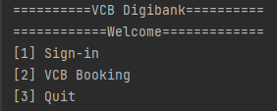
2.1
MAIN SCREEN
When running file Main, the Home menu is displayed with 3 options offered to users:
(Please choose 1 to sign in, 2 to book, and 3 to quit from the program).

Slide 5
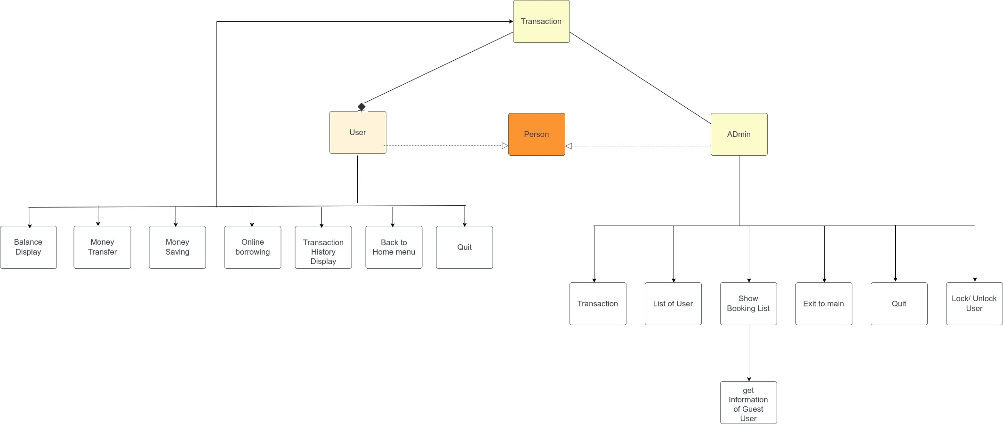
2.2
FUNCTION DETAILS
OVERVIEW FLOWCHART
Notes:
Option 1: sign-in
This main function enables users to choose the following sub-functions:
+ Balance Display
+ Money Transfer
+ Money Saving
+ Online Borrowing
+ Transaction History Display
+ Back to Home menu
+ Quit from the program
2.2. Option 2: booking
2.3. Option 3: quit

Slide 6
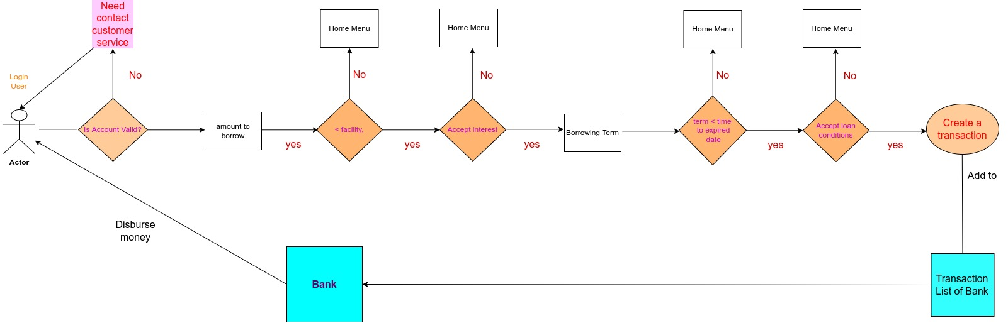
2.2
FUNCTION DETAILS
ONLINE BORROWING

Slide 7
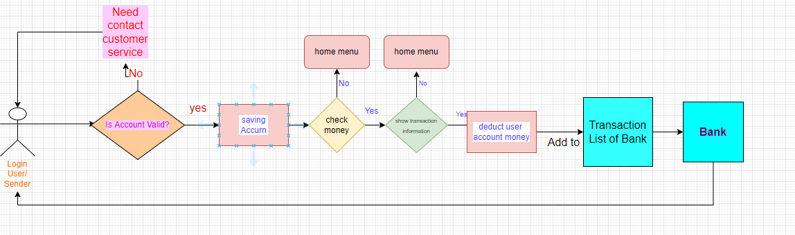
2.2
FUNCTION DETAILS
MONEY SAVING

Slide 8
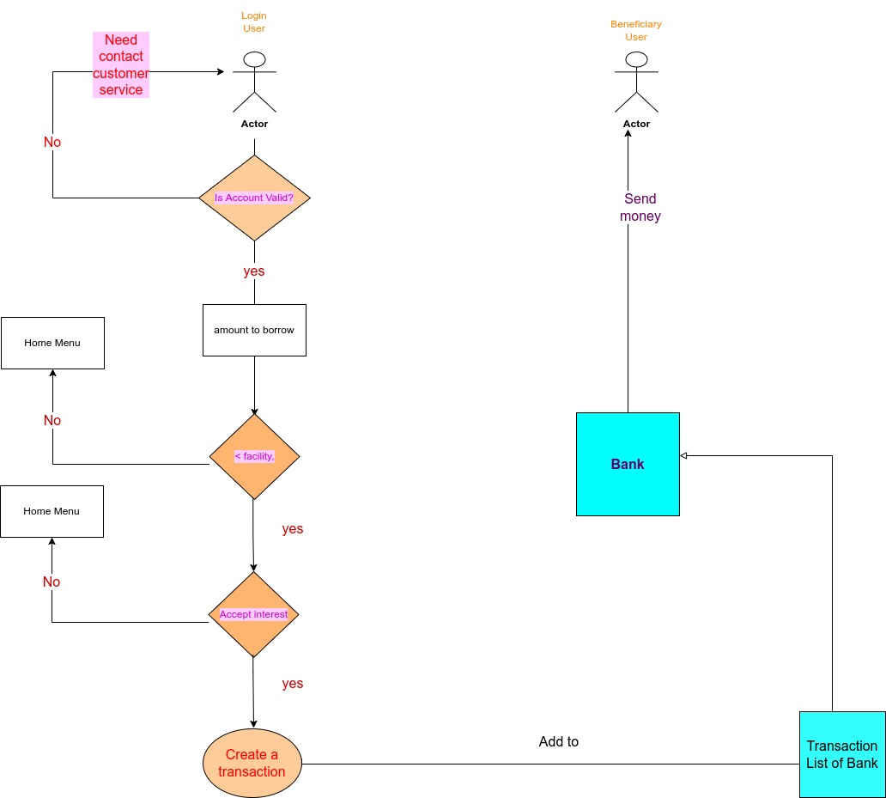
2.2
FUNCTION DETAILS
TRANSFER MONEY

Slide 9
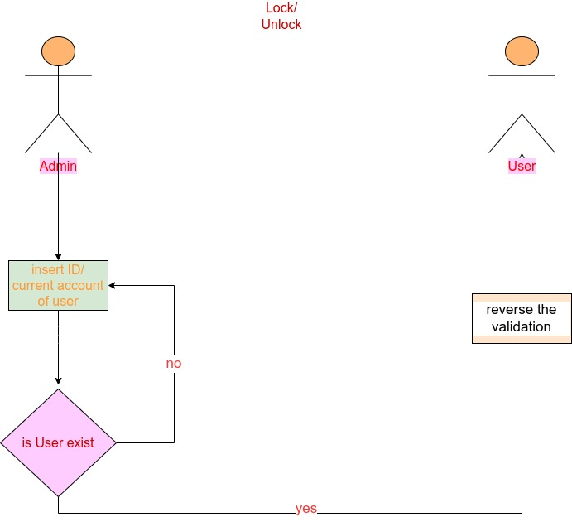
2.2
FUNCTION DETAILS
ADMIN LOCK/UNLOCK USER

Slide 10
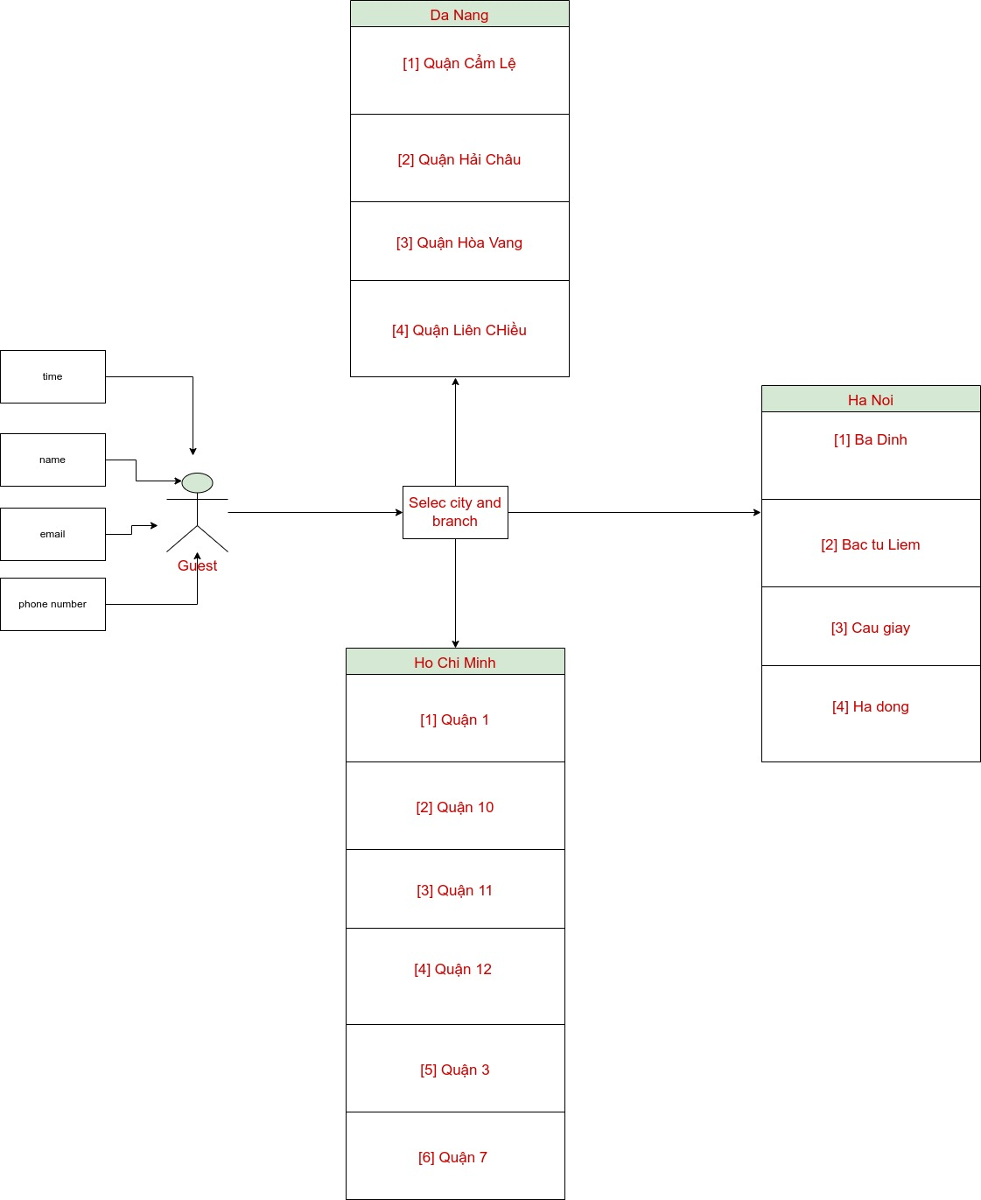
2.2
FUNCTION DETAILS
BOOKING

